Slide 1
Independence (Linear and Affine)
Linear Algebra
Department of Computer Engineering
Sharif University of Technology
Hamid R. Rabiee rabiee@sharif.edu
Maryam Ramezani maryam.ramezani@sharif.edu

Slide 2
Overview
Linear Independence
Functions Linearly Independent
Affine Independence
Affine Combination
Polynomials Linearly Independent

Slide 3
Linear Independence

Slide 4
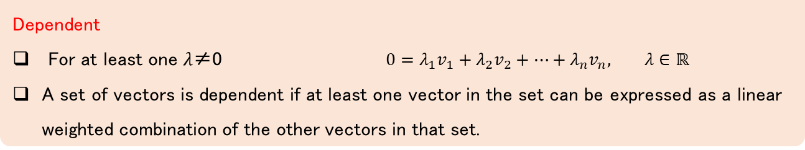
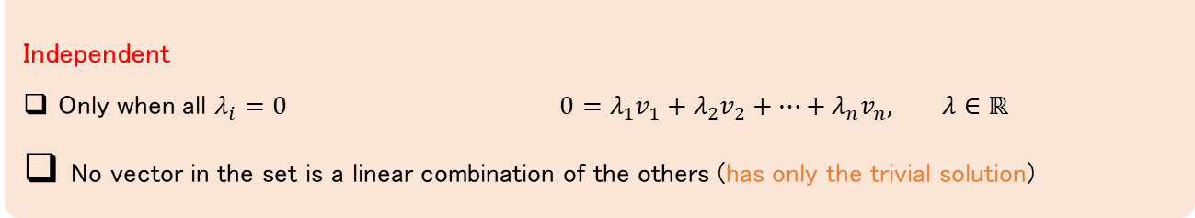
Linear Independence (Algebra)
Definition
Dependent
For at least one 𝜆≠0 $0=λ_{1}v_{1}+λ_{2}v_{2}+…+λ_{n}v_{n}, λ∈ℝ$
A set of vectors is dependent if at least one vector in the set can be expressed as a linear weighted combination of the other vectors in that set.
Definition
Independent
Only when all $λ_{i}=0$ $0=λ_{1}v_{1}+λ_{2}v_{2}+…+λ_{n}v_{n}, λ∈ℝ$
No vector in the set is a linear combination of the others (has only the trivial solution)
Notes:
V(matrix)landa=0
دستگاه معادلات خطی همگن

Slide 5
Linear Independence (Geometry)
Definition
A set of vectors is linear independent if the subspace dimensionality (its span) equals the number of vectors.
Example
vectors spans?
Notes:
1: خطی که از مبدا میگذره. توجه که بردار aنمیتونه بردار صفر باشه ۲: یک صفحه plane شامل آن دو بردار و مبدا
۳: فضای سه بعدی شامل سه بردار و مبدا
As definitions, these two notions are different, but they are related. A subspace has a specific definition, for example: a subset U is a subspace of a vector space V if U is closed under vector addition and scalar multiplication. On the other hand, the span of a nonempty set of vectors S={v_1,v_2,...} is defined to be the set of all (finite, of course) linear combinations of the vectors in S. Here is how they are related:
The span of any nonempty set of vectors is a subspace.
Every subspace is the span of some set of vectors.
One application is in computing solutions to systems of linear equations. If you put the coefficients in a matrix, then the columns will correspond to a set of vectors that span the space of all possible solutions to that system. If you can find a smaller set that spans the space of solutions, such as a basis, then you can reduce the size of your matrix (which corresponds to reducing the number of variables in the system of linear equations).

Slide 6
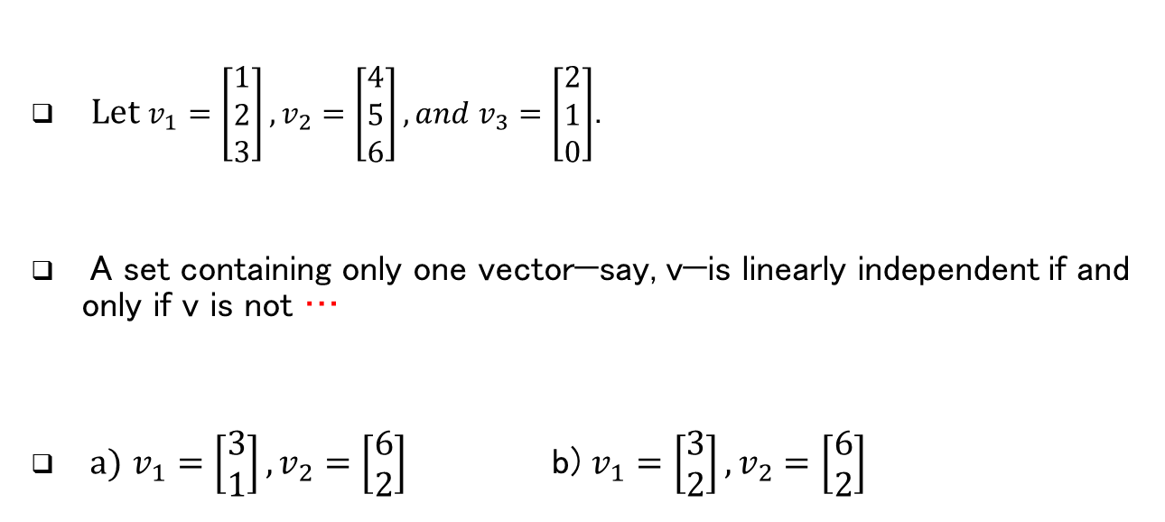
Example
Example
Let $v_{1}=\left[\begin{aligned}1 \\ 2 \\ 3\end{aligned}\right],v_{2}=\left[\begin{aligned}4 \\ 5 \\ 6\end{aligned}\right], and{ v}_{3}=\left[\begin{aligned}2 \\ 1 \\ 0\end{aligned}\right]$.
A set containing only one vector—say, v—is linearly independent if and only if v is not …
a) $v_{1}=\left[\begin{aligned}3 \\ 1\end{aligned}\right],v_{2}=\left[\begin{aligned}6 \\ 2\end{aligned}\right]$ b) $v_{1}=\left[\begin{aligned}3 \\ 2\end{aligned}\right],v_{2}=\left[\begin{aligned}6 \\ 2\end{aligned}\right]$

Slide 7
Properties
Theorem
Any set of vectors that contains the zeros vector is guaranteed to be linearly dependent.

Slide 8
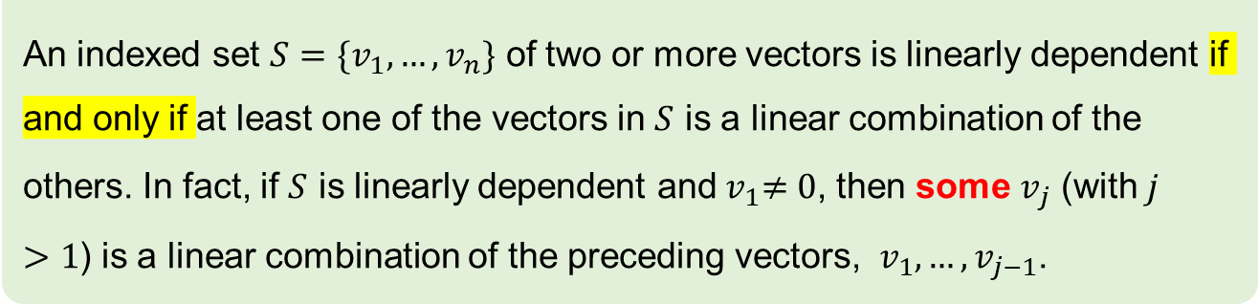
Characterization of Linearly Dependent sets
Theorem
An indexed set $S=\{v_{1},…,v_{n}\}$ of two or more vectors is linearly dependent if and only if at least one of the vectors in $S$ is a linear combination of the others. In fact, if $S$ is linearly dependent and${ v}_{1}≠0$, then some $v_{j}$ (with $j>1$) is a linear combination of the preceding vectors, ${ v}_{1},…,v_{j−1}$.
Does not say that every vector

Slide 9
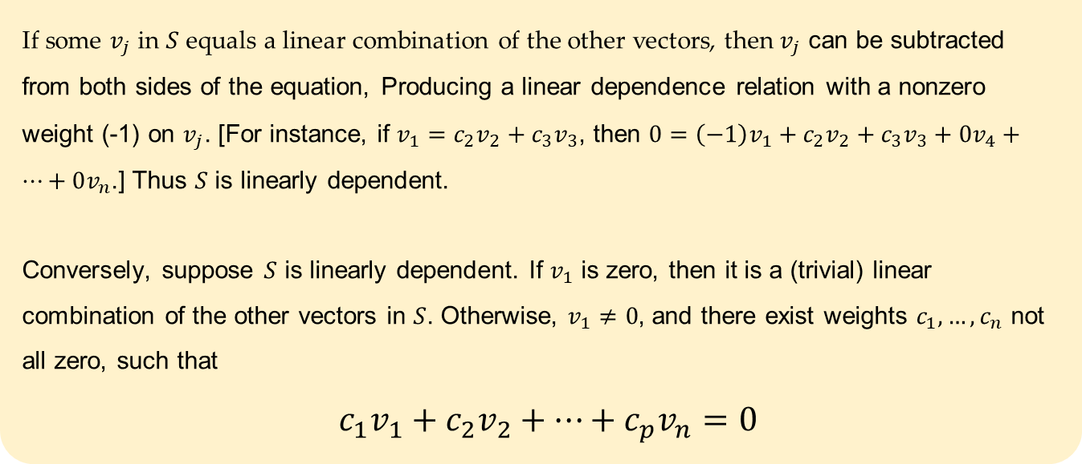
Characterization of Linearly Dependent sets
Proof
If some $v_{j}$ in $S$ equals a linear combination of the other vectors, then $v_{j}$ can be subtracted from both sides of the equation, Producing a linear dependence relation with a nonzero weight (-1) on $v_{j}$. [For instance, if $v_{1}=c_{2}v_{2}+c_{3}v_{3}$, then $0=\left(−1\right)v_{1}+c_{2}v_{2}+c_{3}v_{3}+0v_{4}+…+0v_{n}$.] Thus $S$ is linearly dependent.
Conversely, suppose $S$ is linearly dependent. If $v_{1}$ is zero, then it is a (trivial) linear combination of the other vectors in $S$. Otherwise, $v_{1}≠0$, and there exist weights $c_{1},…,c_{n}$ not all zero, such that
$c_{1}v_{1}+c_{2}v_{2}+…+c_{p}v_{n}=0$

Slide 10
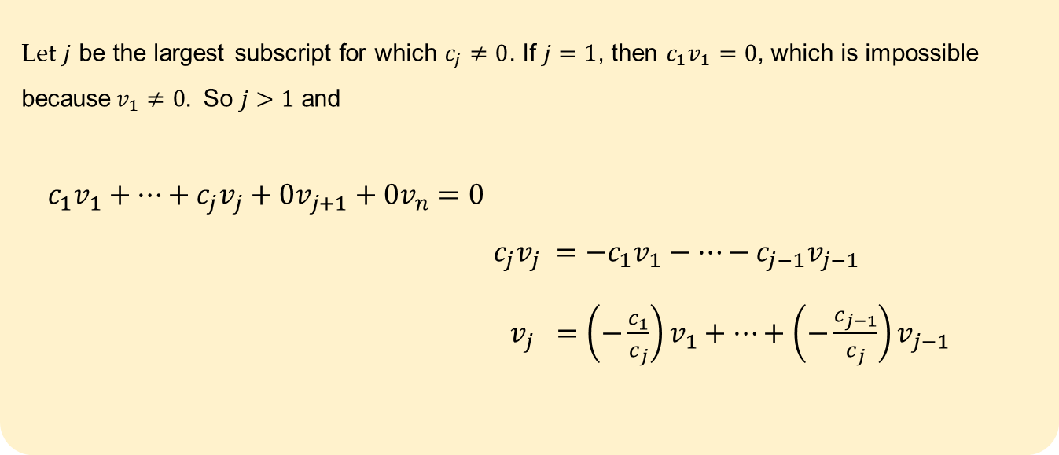
Characterization of Linearly Dependent sets
Proof
Let $j$ be the largest subscript for which $c_{j}≠0$. If $j=1$, then $c_{1}v_{1}=0$, which is impossible because$v_{1}≠0$. So $j>1$ and
$${ c}_{1}v_{1}+…+c_{j}v_{j}+0v_{j+1}+0v_{n}=0$$
$c_{j}v_{j} =−c_{1}v_{1}−…−c_{j−1}v_{j−1}$
$v_{j} =\left(−\frac{c_{1}}{c_{j}}\right)v_{1}+…+\left(−\frac{c_{j−1}}{c_{j}}\right)v_{j−1}$

Slide 11
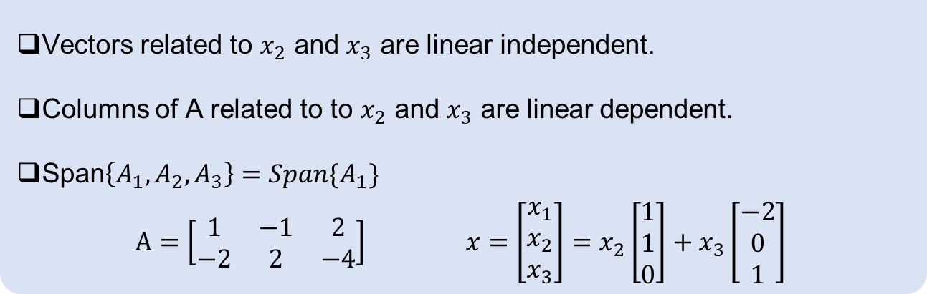
Properties
The vectors coming from the vector form of the solution of a matrix equation Ax = 0 are linearly independent
Example
Vectors related to $x_{2}$ and $x_{3}$ are linear independent.
Columns of A related to to $x_{2}$ and $x_{3}$ are linear dependent.
Span$\left\{A_{1},A_{2},A_{3}\right\}=Span\{A_{1}\}$
$$A=\left[\begin{matrix}1 & −1 & 2 \\ −2 & 2 & −4\end{matrix}\right] x=\left[\begin{aligned}x_{1} \\ x_{2} \\ x_{3}\end{aligned}\right]=x_{2}\left[\begin{aligned}1 \\ 1 \\ 0\end{aligned}\right]+x_{3}\left[\begin{aligned}−2 \\ 0 \\ 1\end{aligned}\right]$$
Notes:
V(matrix)landa=0
دستگاه معادلات خطی همگن

Slide 12
Properties
Important
If a collection of vectors is linearly dependent, then any superset of it is linearly dependent.
Any nonempty subset of a linearly independent collection of vectors is linearly independent.

Slide 13

Properties
Theorem
Any set of $M>N$ vectors in $ℝ^{n}$ is necessarily dependent.
Any set of $M≤N$ vectors in $ℝ^{n}$ could be linearly independent.
Notes:
ماتریس
N*M

Slide 14
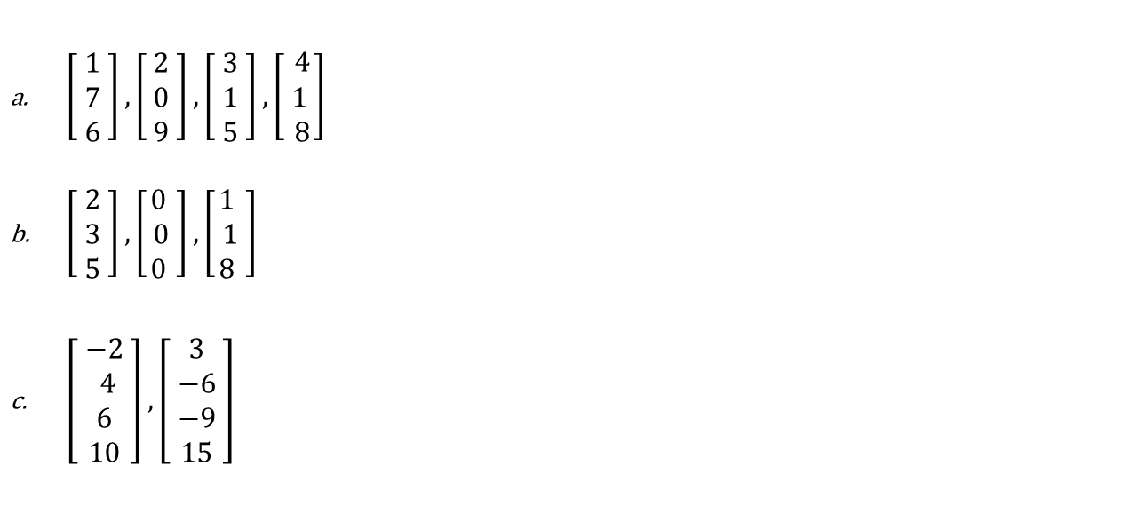
Example
Example
$\left[\begin{aligned}1 \\ 7 \\ 6\end{aligned}\right],\left[\begin{aligned}2 \\ 0 \\ 9\end{aligned}\right],\left[\begin{aligned}3 \\ 1 \\ 5\end{aligned}\right],\left[ \begin{aligned}4 \\ 1 \\ 8\end{aligned}\right]$
$\left[ \begin{aligned}2 \\ 3 \\ 5\end{aligned} \right],\left[\begin{aligned}0 \\ 0 \\ 0\end{aligned} \right],\left[\begin{aligned}1 \\ 1 \\ 8\end{aligned} \right]$
$\left[ \begin{aligned}−2 \\ 4 \\ 6 \\ 10\end{aligned} \right],\left[ \begin{aligned}3 \\ −6 \\ −9 \\ 15\end{aligned} \right]$

Slide 15
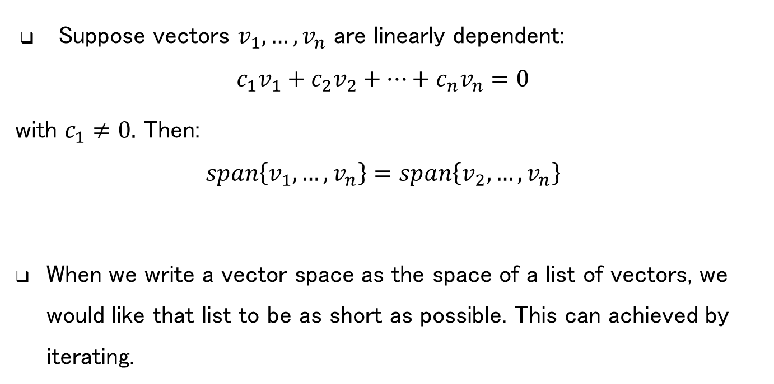
Linear Dependent Properties
Suppose vectors $v_{1},…,v_{n}$ are linearly dependent:
$$c_{1}v_{1}+c_{2}v_{2}+…+c_{n}v_{n}=0$$
with $c_{1}≠0.$ Then:
$$span\left\{v_{1},…,v_{n}\right\}=span\left\{v_{2},…,v_{n}\right\}$$
When we write a vector space as the space of a list of vectors, we would like that list to be as short as possible. This can achieved by iterating.
Notes:
ترکیب خطی همه رو بنویس
V1
رو برحسب بقیه جایگزین کن
آخرش ترکیب خطی از
V2 تا vn
به دست بیار

Slide 16
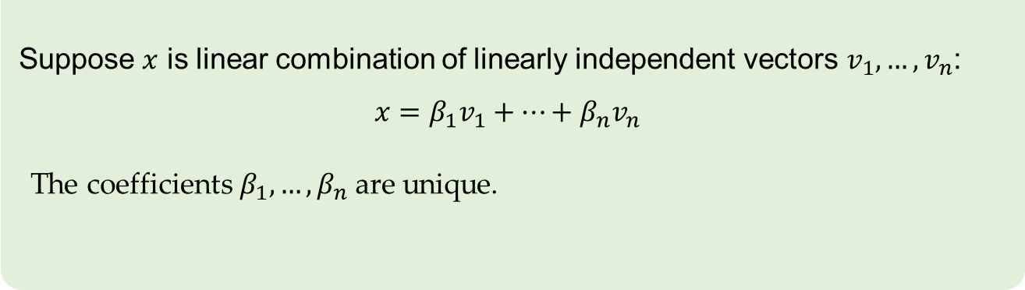
Linear combinations of linearly independent vectors
Theorem
Suppose $x$ is linear combination of linearly independent vectors $v_{1},…,v_{n}$:
$$x=β_{1}v_{1}+…+β_{n}v_{n}$$
The coefficients $β_{1},…,β_{n}$are unique.
Proof

Slide 17
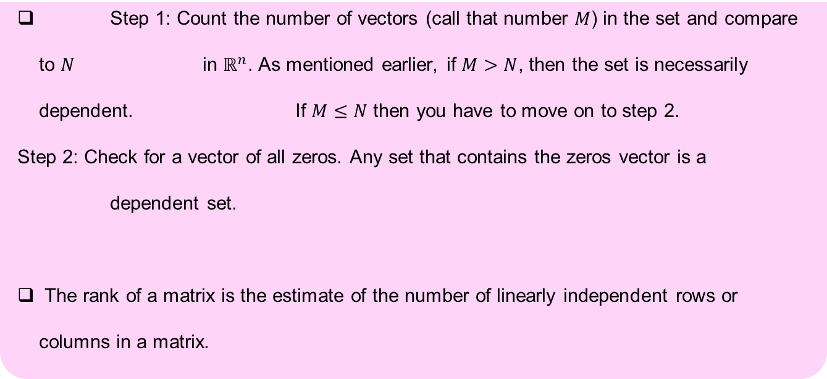
Conclusion
Important
Step 1: Count the number of vectors (call that number $M$) in the set and compare to $N$ in $ℝ^{n}$. As mentioned earlier, if $M>N$, then the set is necessarily dependent. If $M≤N$ then you have to move on to step 2.
Step 2: Check for a vector of all zeros. Any set that contains the zeros vector is a dependent set.
The rank of a matrix is the estimate of the number of linearly independent rows or columns in a matrix.

Slide 18
Functions Linearly Independent

Slide 19
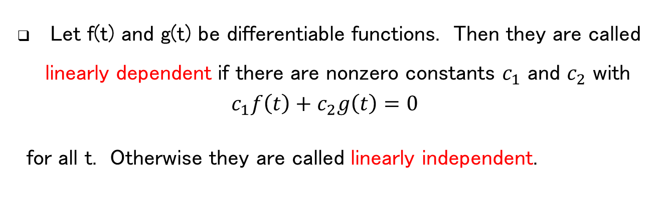
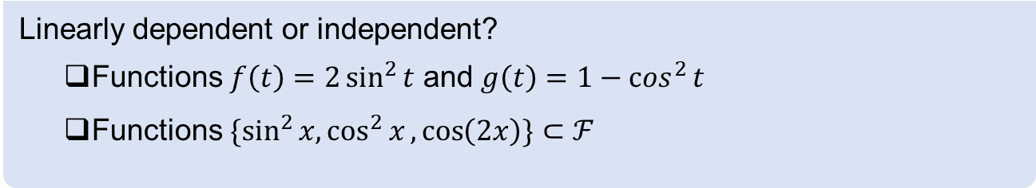
Functions Linearly Independent
Let f(t) and g(t) be differentiable functions. Then they are called linearly dependent if there are nonzero constants $c_{1}$ and $c_{2}$ with
$$c_{1}f\left(t\right)+c_{2}g\left(t\right)=0$$
for all t. Otherwise they are called linearly independent.
Example
Linearly dependent or independent?
Functions $f\left(t\right)=2\sin^{2}{t}$ and $g\left(t\right)=1−\cos^{2}{t}$
Functions $\{\sin^{2}{x,\cos^{2}{x}},\cos\left(2x\right)\}⊂ℱ$
Notes:
اولی وابسته خطی
ضرایب ۱ و -۲
دومی وابسته خطی ضرایب از چپ به راست باشد:
1,-1,1
Cos(2x)=cos^2(x)-sin^2(x)

Slide 20
Polynomials Linearly Independent

Slide 21
Vector Space of Polynomials
Example
Are $\left(1−x\right),\left(1+x\right),x^{2}$ linearly independent?
Notes:
https://www.youtube.com/watch?v=SzZaQnzstfE
برای پایه چک کردن در چند جمله ای ها
باید چک کنیم ایا مستقل خطی هستند؟ بالاش دیدم بله
دوم: ایا فضا را اسپن میکنن؟ هر چند جمله ای با درجه دوم را میسازند؟

Slide 22
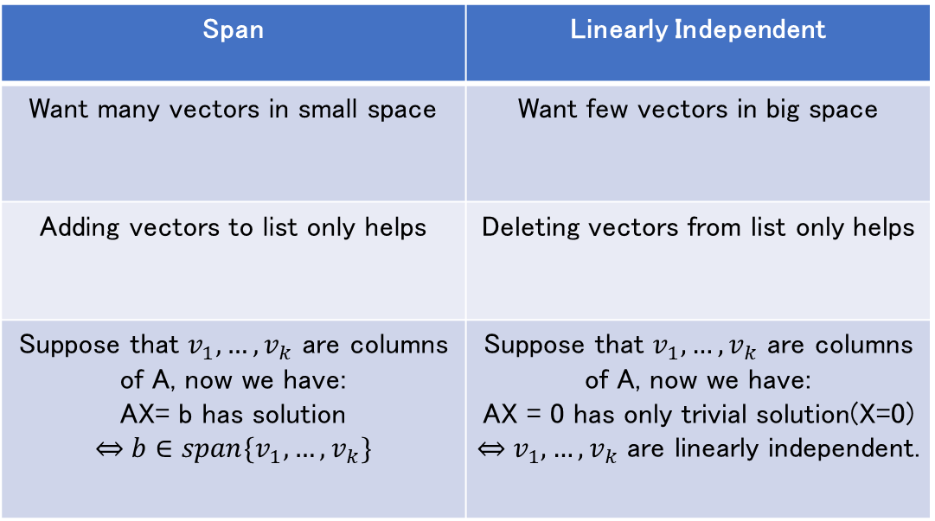
Linearly Independent Sets versus Spanning Sets
Span | Linearly Independent
Want many vectors in small space | Want few vectors in big space
Adding vectors to list only helps | Deleting vectors from list only helps
Suppose that $v_{1},…,v_{k}$ are columns of A, now we have: AX= b has solution $$\overset{⇔}{ } b∈span\{v_{1},…,v_{k}\}$$ | Suppose that $v_{1},…,v_{k}$ are columns of A, now we have: AX = 0 has only trivial solution(X=0) $\overset{⇔}{ } v_{1},…,v_{k}$ are linearly independent.

Slide 23
Affine Combination

Slide 24
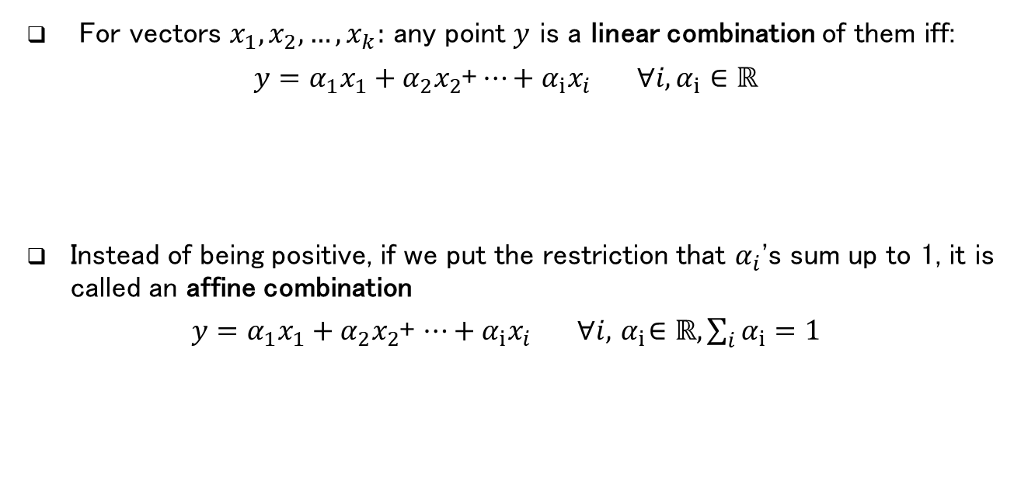
Combinations
For vectors $x_{1},x_{2},…,x_{k}:$ any point $y$ is a linear combination of them iff:
$y={α_{1}x}_{1}+{α_{2}x}_{2}$+$⋯+{α_{i}x}_{i} ∀i, α_{i}∈ℝ$
Instead of being positive, if we put the restriction that $α_{i}$'s sum up to 1, it is called an affine combination
$y={α_{1}x}_{1}+{α_{2}x}_{2}$+ $⋯+{α_{i}x}_{i} ∀i,{ α}_{i}∈ℝ,\sum_{i}{α_{i}=1}$

Slide 25

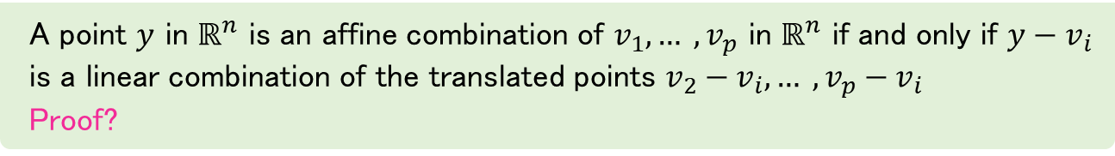
Affine
Theorem
A point $y$ in $ℝ^{n}$ is an affine combination of $v_{1},… ,v_{p}$ in $ℝ^{n}$ if and only if $y−v_{i}$ is a linear combination of the translated points $v_{2}−v_{i},… ,v_{p}−v_{i}$
Proof?
Example
Find a vector equation and parametric equations of the plane in${ ℝ}^{4}$ that passes through
$(−17, 6, 29, 0), (−13, 3, 25, −2)$and$(−15, 6, 25, −1)$.

Slide 26
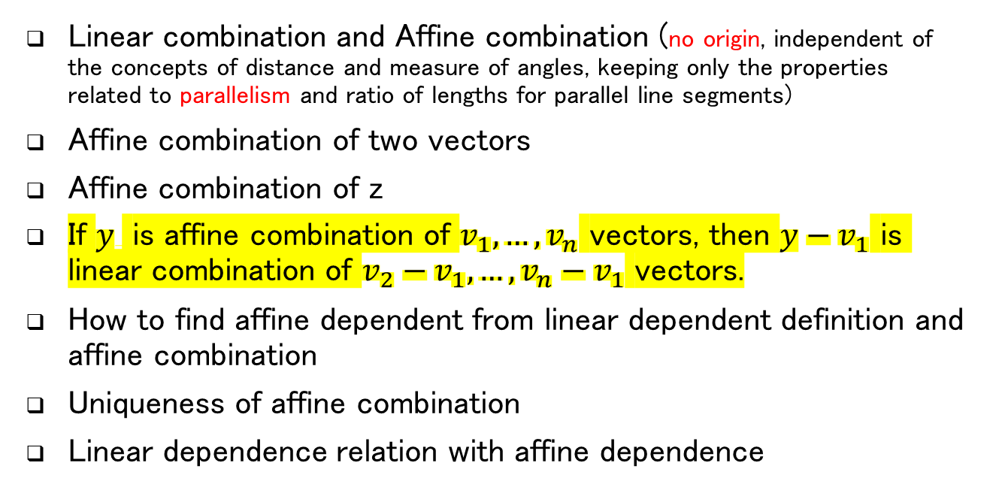
Review
Linear combination and Affine combination (no origin, independent of the concepts of distance and measure of angles, keeping only the properties related to parallelism and ratio of lengths for parallel line segments)
Affine combination of two vectors
Affine combination of z
If $y$ is affine combination of $v_{1},…,v_{n}$ vectors, then $y−v_{1}$ is linear combination of $v_{2}−v_{1},…,v_{n}−v_{1}$ vectors.
How to find affine dependent from linear dependent definition and affine combination
Uniqueness of affine combination
Linear dependence relation with affine dependence
A
2
V
C
Z
1
B
W

Slide 27
Affine Independence

Slide 28
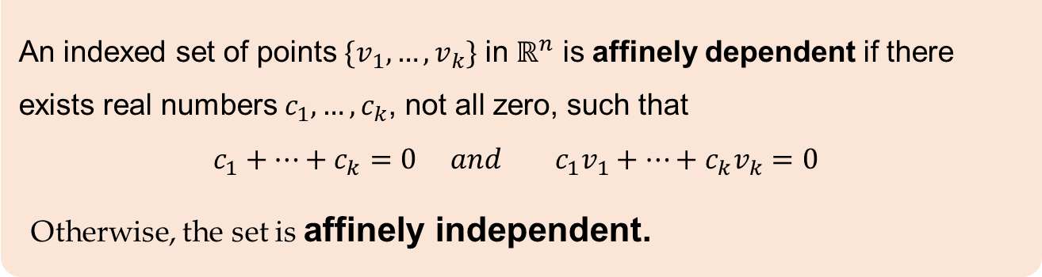

Affine Independence
Definition
An indexed set of points $\{v_{1},…,v_{k}\}$ in $ℝ^{n}$ is affinely dependent if there exists real numbers $c_{1},…,c_{k}$, not all zero, such that
$$c_{1}+…+c_{k}=0 and{ c}_{1}v_{1}+…+c_{k}v_{k}=0$$
Otherwise, the set is affinely independent.
Example
$\{v_{1}\}$

Slide 29
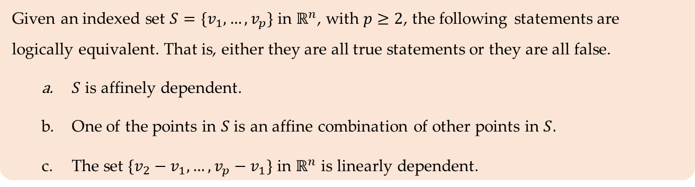
Affine Independence
Note
Given an indexed set $S=\{v_{1},…,v_{p}\}$ in $ℝ^{n}$, with $p≥2$, the following statements are logically equivalent. That is, either they are all true statements or they are all false.
$S$ is affinely dependent.
One of the points in $S$ is an affine combination of other points in $S.$
The set $\{v_{2}−v_{1},…,v_{p}−v_{1}\}$ in $ℝ^{n}$ is linearly dependent.
$ℝ^{n}$contains at most $n+1$ affinely independent points

Slide 30
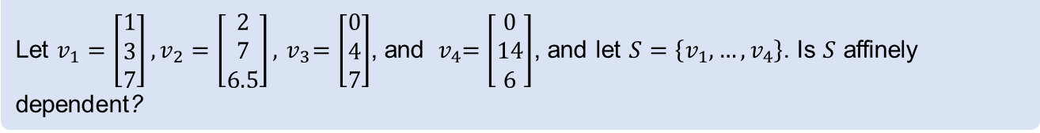
Example
Example
Let $v_{1}=\left[\begin{aligned}1 \\ 3 \\ 7\end{aligned}\right],v_{2}=\left[\begin{aligned}2 \\ 7 \\ 6.5\end{aligned}\right], { v}_{3}=\left[\begin{aligned}0 \\ 4 \\ 7\end{aligned}\right]$, and ${ v}_{4}=\left[\begin{aligned}0 \\ 14 \\ 6\end{aligned}\right]$, and let $S=\left\{v_{1},…,v_{4}\right\}$. Is $S$ affinely dependent?

Slide 31
Conclusion : Linear and Affine
Affine Dependent
?
Linear Dependent
?
?
?
?
?
Affine Independent
Linear Independent
?
?

Slide 32
Reference
Page 97 LINEAR ALGEBRA: Theory, Intuition, Code
Page 213: David Cherney,
Page 54: Linear Algebra and Optimization for Machine Learning

Slide 33
